Slide 1

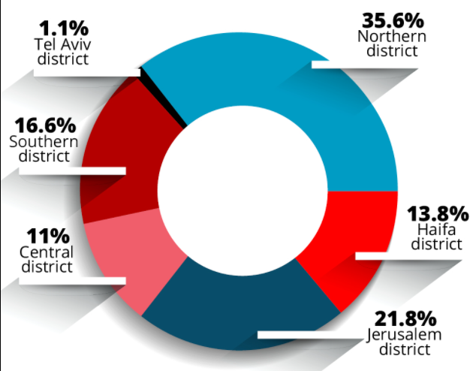
is There a connection between Social-economic status
TO COVID-19 SPREAD?
Adi Levy & Daniel Markov

Slide 2

BACKGROUND
Covid-19 appeared suddenly and infected a lot of countries.
In our project we investigated the connection between the plague and the Socio-economic rate at chosen infected cities in Israel.
We chose 22 cities: 11 high Social economic rate, and 11 low.
For each city that we chose for high rate we had approximately the same population amount for the low one’s so we can check if there is connection between the information.

Slide 3
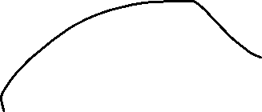

Main steps
Research Question
Collecting Data
Cleaning the data
Visualizations
Machine Learning

Slide 4
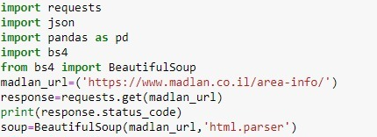
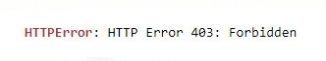
Crawling
Crawling- Madlan
At first, we wanted to crawl data from “Madlan” site that has the most information about cities in Israel.
The site is blocked for crawling, bots and they rejected us.
The result:

Slide 5
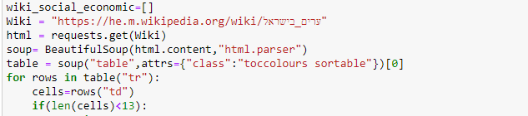
Crawling
Crawling- Wikipedia.

Slide 6
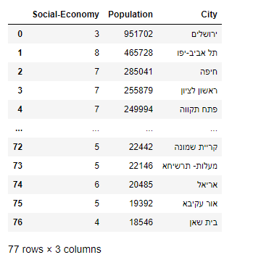
Data scrapping from Wikipedia
Crawling- Wikipedia
From Wikipedia we scrapped parameters for each City:
City Name , Population , Social Economic Rate

Slide 7
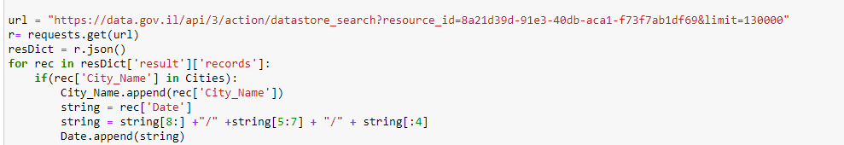
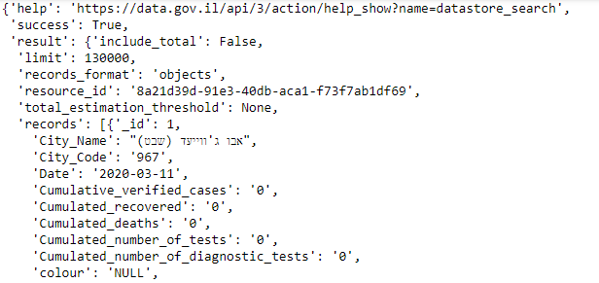
api
API – data.gov.il
We pulled data in API method.

Slide 8
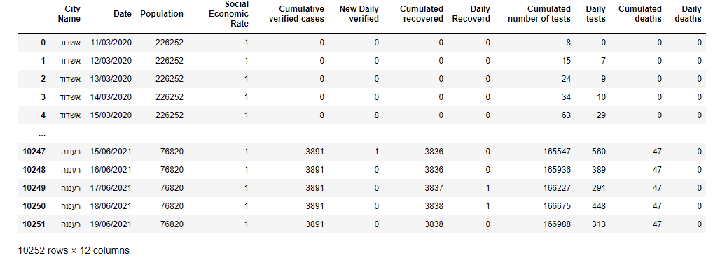
Api & crawling
API- data.gov.il
Crawling- Wikipedia.
The data in the data frame after merged with the scrapped data.

Slide 9
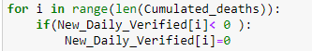
Crawling and api data collect AND CLEAN
According to our data- we created new columns to our dataset based on existing information that helped us a lot to analyze our question.
Daily Deaths , Daily Tests , New Daily Verified , Daily Recovered.
Clean the Data
We had to clean the data, when we pulled the data columns like date, it was presented as U.S date format and we had to change it.
In addition- “NAN” values wasn’t exist but when we wanted to know for the first days how many Cases , deaths , Recovered tests we had it was presented by “<15” as string.
we changed it into numeric parameter and the value that we put was approximately the median- 8 as integer.
Many cities presented the first day wrongly, in this case our tables “Daily” ones had negative values so we put it as 0. for not losing critical information.

Slide 10
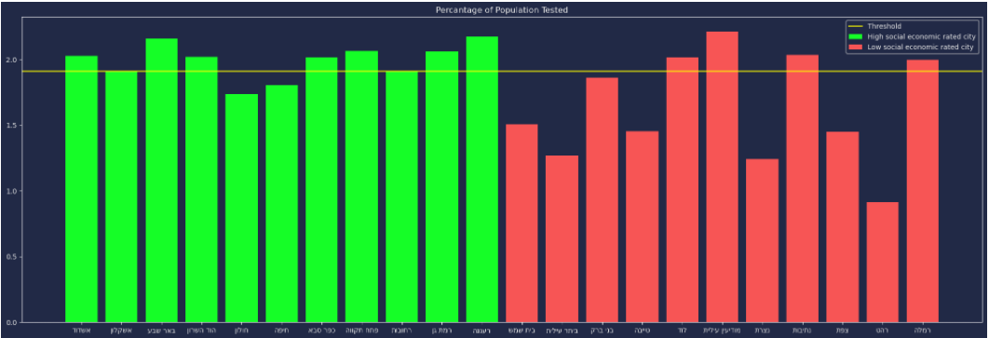
Visualization
Our graphs will compare between high and low social economic rate cities.
At first, we wanted to check if there’s a connection between number of tests that people took in low\high social economic rate cities.
Here is the graph, It shows that we have connection between the things.
As we can see the number of tests per person is almost 2 in the high economic rate and at low economic rate city is roughly 1.5-1.6 per person.
Left Side- High social economic rated.
Right Side- Low social economic rated.

Slide 11
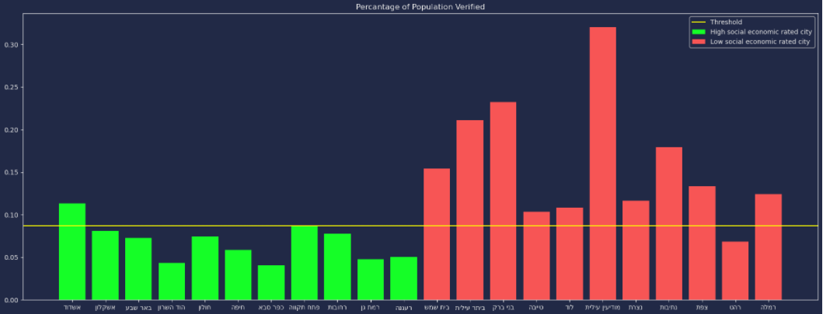
Visualization
This graph will compare between low and high rated cities in verified percentage
We can see clearly that low social economic rate cities have higher percentage than the high rated.

Slide 12
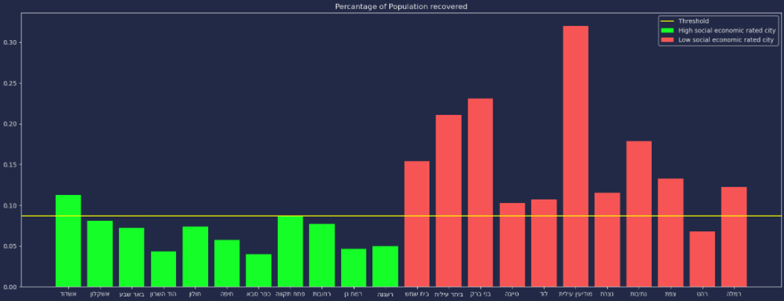
Visualization
This graph will show the recover percentage that has linear connection to verified
We can see connection between the previous graph percentage of verified rate.

Slide 13
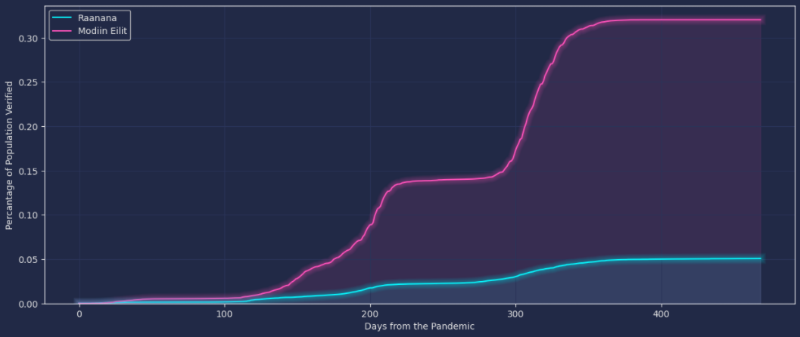
Visualization
We chose graph that will verify our research we will present compare between 2 cities in verified percentage parameter.
Raanana vs. Modiin Eilit

Slide 14
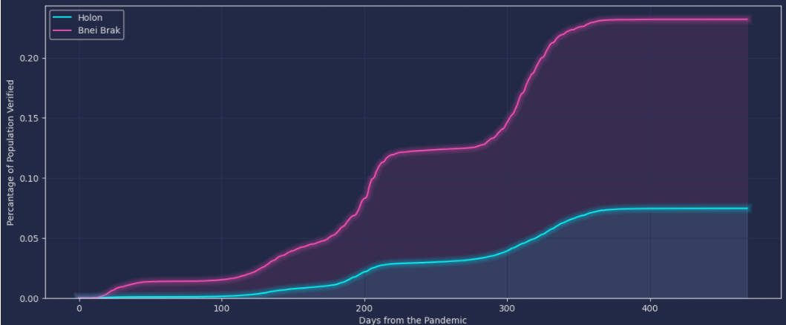
Visualization
Holon vs. Bnei brak

Slide 15
Visualization
We presented the data in graphs we will explain 2 things that prevented the gap be even larger between the chosen cities.
Lockdown - we can see the big raise of verified between the 100th -200th days since the pandemic started.
After 180-190 days approximately 6 months the government decided to do lockdown for 21days (21-09-20) the reason that we see the graph reaches to the peak after 210-220 days is the lockdown that made the Infection coefficient decrease drastically.
Another big raise incoming in the 300th day because the lockdown released due too the vaccines that started a month earlier
Vaccines – The first Vaccine day was 19-12-20 about 270 from the start of pandemic. We can se the 2nd big raise of verified people occurred after 280 days approximately until 360th day from the beginning. 360th days is about Mar-21 in this month Israel has reached to almost 50% completely vaccinated that prevented the covid spread again.

Slide 16
Visualization
After we presented the data in graphs we can see that there is clear difference between low, high social economic rated cities.
•In verified percentage, recovered.
•In number of tests per person.

Slide 17

Prediction machine learning
In this stage we wanted to predict social economic rate – high or low.
We used 3 types of Machine Learning algorithms.
•Logistic Regression that provided 91% accuracy
•KNN that provided 97% accuracy
•Decision Tree that provided 99.9% accuracy that is almost perfect!

Slide 18
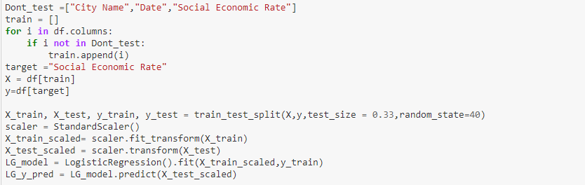
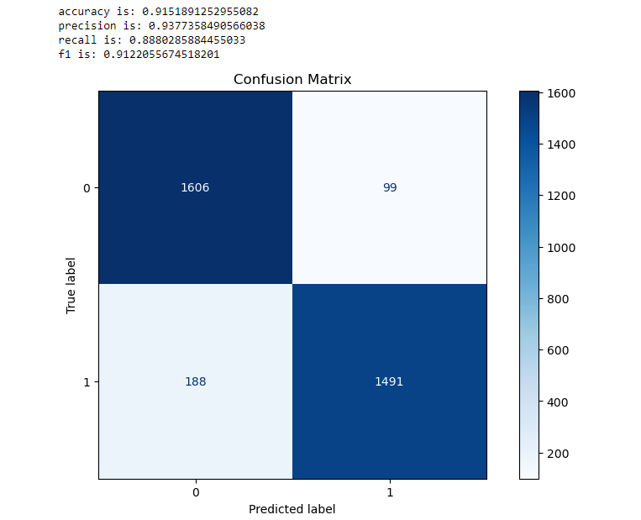
Prediction machine learning
Logistic Regression:
At first we checked the classic method Logistic Regression
We saw that we have 91%.
Then we wanted to check if we can improve the model.

Slide 19
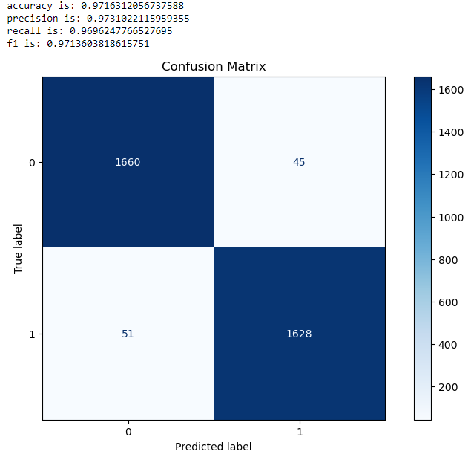
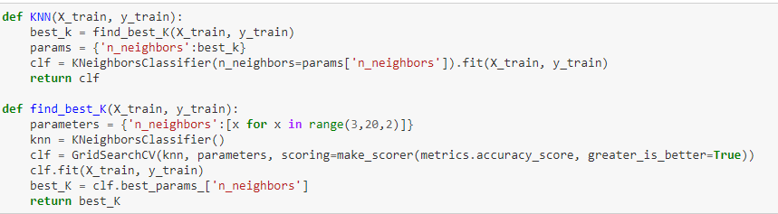
Prediction machine learning
KNN:
After the Logistic Regression that provided 91% we checked the KNN model.
We used a function that will find the best Hyperparameter (best K)
and we saw 97% that’s 6% better than the Previous Model.
We wanted to check another model to see if there is any chance to get closer or maybe to100%

Slide 20
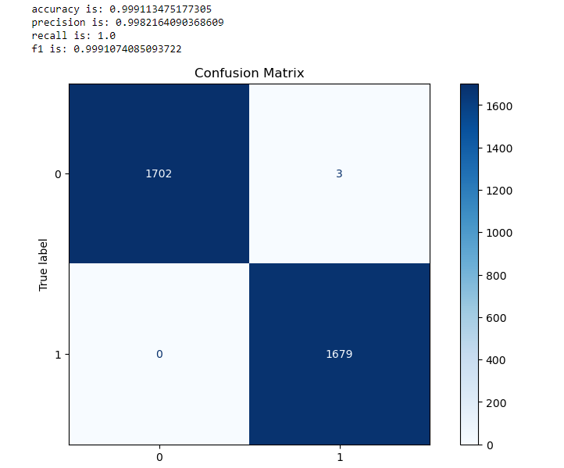
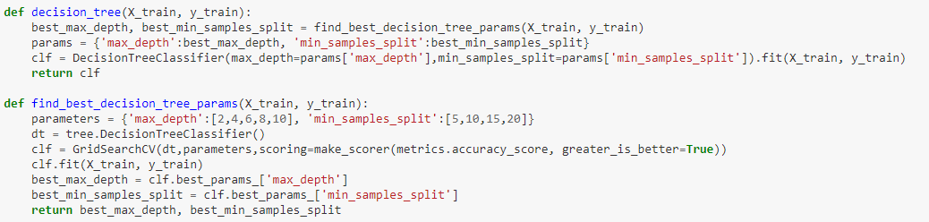
Prediction machine learning
Decision Tree:
After the KNN algorithm that provided 97% we checked the Decision Tree.
We used function that will find the best Hyperparameters. (max depth & min samples split)
We saw amazing improvement from 91% (Logistic Regression)
To 99.9% Decision Tree We found the best model to our question that predicted the best results.

Slide 21
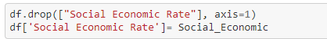
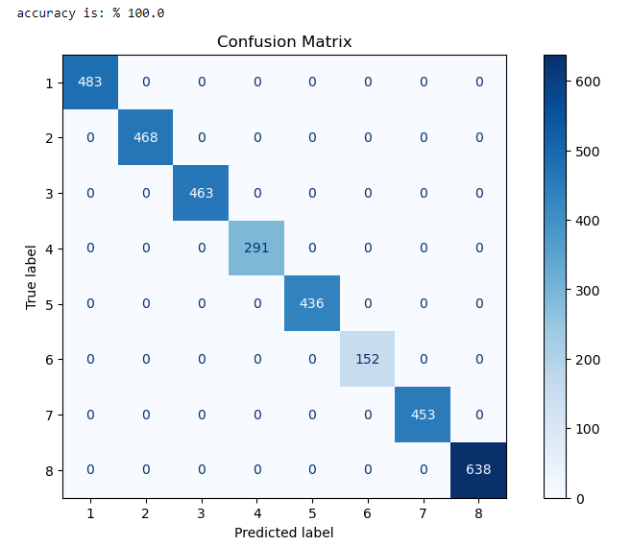
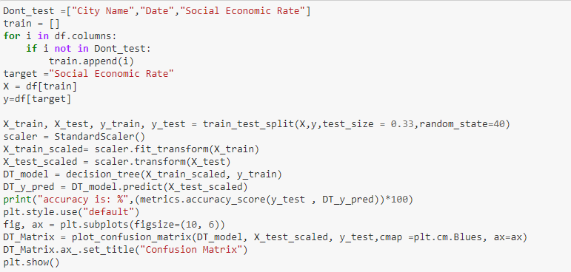
WOW EFFECT BY MACHINE LEARNING
We wanted to check if our algorithm can predict the other side of the question- what is the social economic rate in city according to our data.
Prediction made by real social economic rate and not 0-1 values.
The results were astounding- 100% Accuracy model

Slide 22
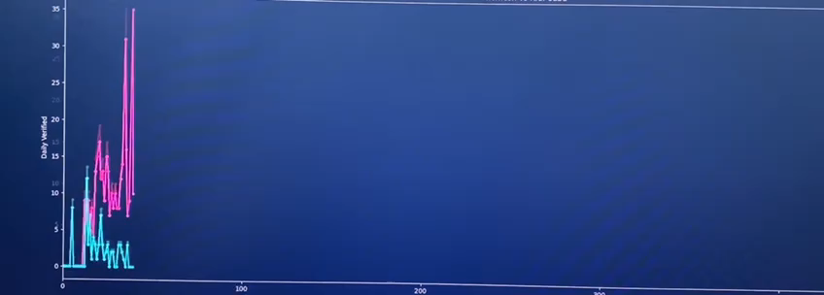
WOW EFFECT BY Visualization
Live Plot – number of daily verified cases since pandemic started in 2 different social economic rated cities.
X-axis – number of days since Covid-19 started
Y-axis – number of verified cases in each city
Purple – low social-economic rated city
Blue - high social-economic rated city

Slide 23
CONCLUSION
We can see that our research show that there’s strict connection between high/low social economic rated cities to the pandemic.
We know that in low rated cities the number of verified is approximately 5 times more than the high rated cities.
It makes us understand that most of the people who live in low rated cities care less about another people.
The low social-economic rated cities “believe” that the instructions are not relevant for them and this is the main cause to the gap between the cities that we saw during the research.
And the high social-economic rated cities cares more about their life.

